Slide 1
DevOps

Slide 2
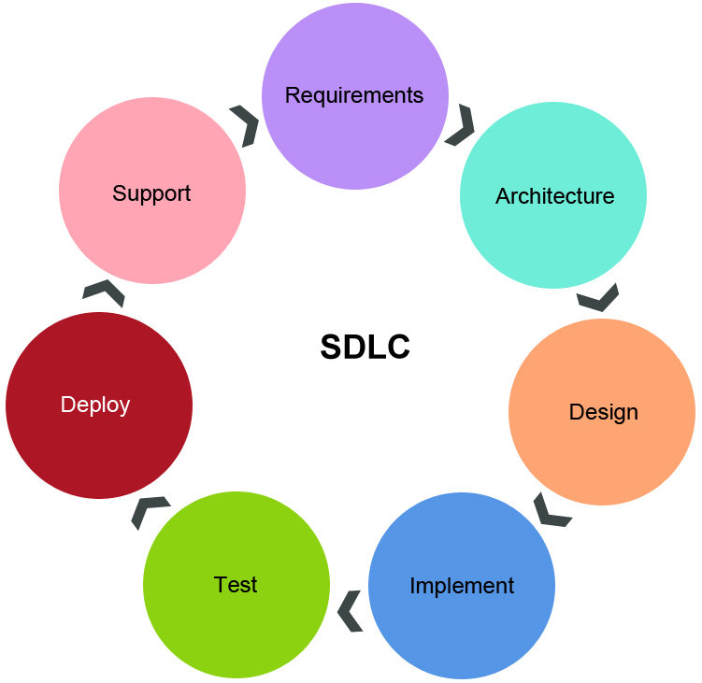
A recapitulation on SDLC
Customer demands reduced time to delivery

Slide 3
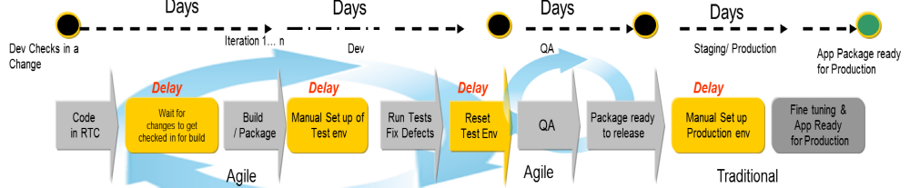
Agile addresses part of this demand

Slide 4

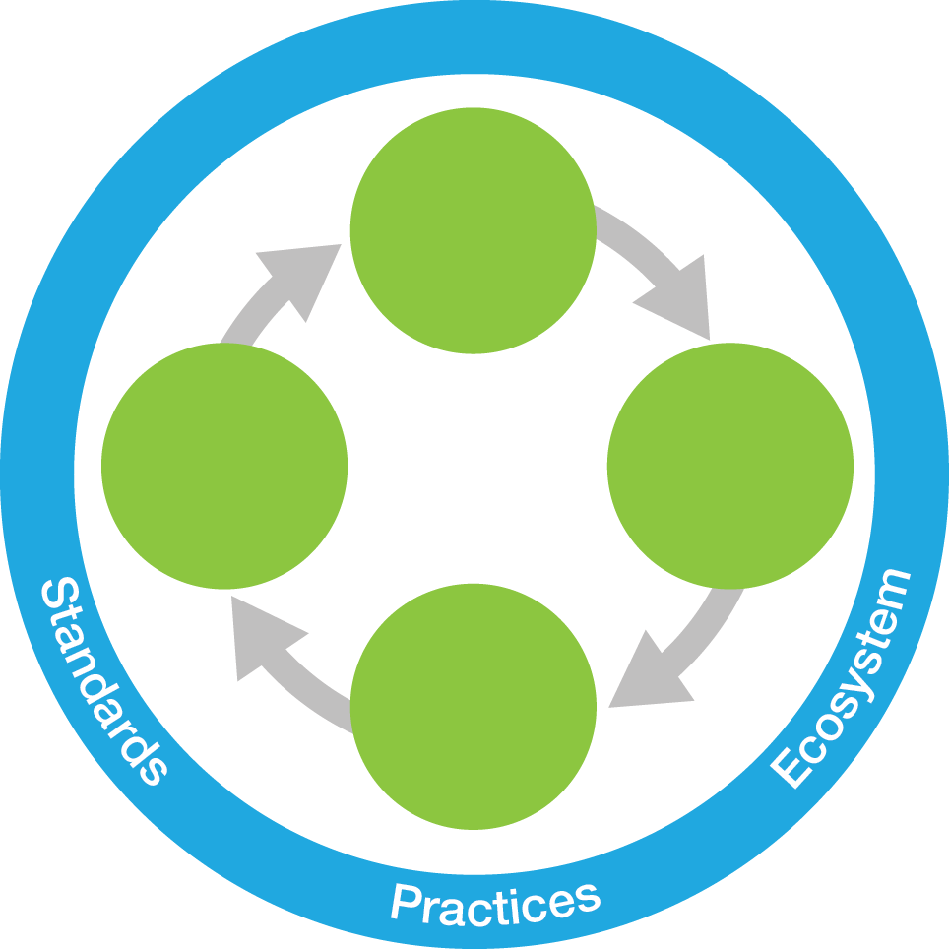





DevOps Provides a Framework for Continuous Everything
Continuous business planning:
Continuous monitoring:
Steer
Collaborative development:
DevOps
Continuous
Feedback
Operate
Develop /
Test
Continuous customer feedback and optimization:
Continuous integration and testing:
Deploy
Continuous release and deployment:

Slide 5
Continuous Business Planning
Encourage early customer and stakeholder feedback
Continuous adjustments to software project management
Capabilities
  Release planning
  Change management
  Dashboards
  Traceability
  Test management and execution
Notes:
test

Slide 6
Continuous Business Planning
Tools
  HP Application Lifecycle Management tools
  Rational Team Concert
  Rational DOORS Next Generation
  Tuleap
  MS Project
  Other project management tools...
Notes:
test

Slide 7
Collaborative Development
All stakeholders having access to the same set of tools
Focus is on deliver quality customer experiences with speed
Capabilities
  Configuration management
  Build management (requires integration with build automation)
  Change management
  Traceability
  Test management and execution
Notes:
test

Slide 8
Collaborative Development
Tools
  HP Application Lifecycle Management tools
  Tuleap
  Version Control Tools
  Integrated Development Environments
    Including mobile development environments like IBM MobileFirst Platform Studio, Xamarine etc..
  Maven
  Jenkins
Notes:
test

Slide 9
Continuous Integration
Members of a team integrate their work frequently
  usually, each person integrates at least daily
  leading to multiple integrations per day.
Each integration is verified by an automated build (including test) to detect integration errors as quickly as possible
Capabilities
  Configuration management
  Build management (requires integration with build automation)
  Change management
  Traceability
  Test management and execution
Notes:
test

Slide 10
Continuous Integration
Tools
  Version control tools
    Microsoft Team Foundation Server
    Git
    CVS
    ClearCase
  Build Tools (Build includes unit test)
    Shell Scripts.
    Make.
    Ant (https://ant.apache.org/ )
    nANT (http://nant.sourceforge.net/ )
    MSBuild (https://docs.microsoft.com/en-us/visualstudio/msbuild/msbuild?view=vs-2017 )
    Maven (https://maven.apache.org/ )
    Gradle (https://gradle.org/ )
Notes:
test

Slide 11
Continuous Testing
Software quality assurance delivered with speed at reduced risk and cost
Capabilities
  Configuration management
  Build management (requires integration with build automation)
  Change management
  Traceability
  Test management and execution
Notes:
test

Slide 12
Continuous Testing
Tools
  HP Application Lifecycle Management tools
  HP QuickTest Professional
  Load Runner
  Selenium
  Jmeter
  Rational Functional Tester
  Rational Performance Tester
  Rational Quality Manager
Notes:
test

Slide 13
Continuous Release and Deploy
Enable frequent application deployment at reduced cost and risk
Capabilities
  Release management
  Environment management (provisioning automation)
  Deployment automation (application, middleware, and databases)
Notes:
test

Slide 14
Continuous Release and Deploy
Tools
  IBM UrbanCode Deploy
  IBM UrbanCode Release
  Chef
  Puppet
  Jenkins
Notes:
test

Slide 15
Continuous Monitoring, Customer Feedback and Optimization
Taking application monitoring and feedback to the next level of accommodating the customer’s perspective
Capabilities
  Monitor capacity and optimize
  Monitor performance and optimize
  Monitor user experience and optimize
  Event and incident management
  Capture, analyse, and prioritize business requirements
  Project planning
  Measure to project metrics
  Traceability
  Dashboard
Notes:
test

Slide 16
Continuous Monitoring, Customer Feedback and Optimization
Tools
  Chef
  Puppet
  Analytics tools like
    IBM Digital Analytics
    IBM SmartCloud Analytics—Log Analysis
  Monitoring tools like
    IBM SmartCloud Monitoring— Application Insight
Notes:
test

Slide 17
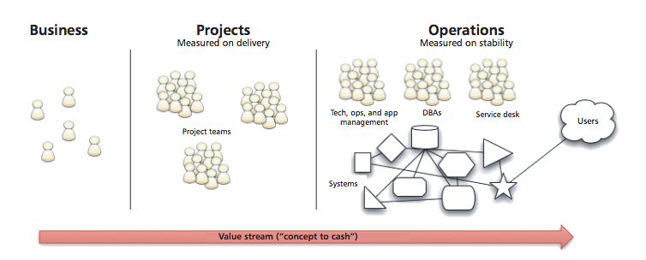
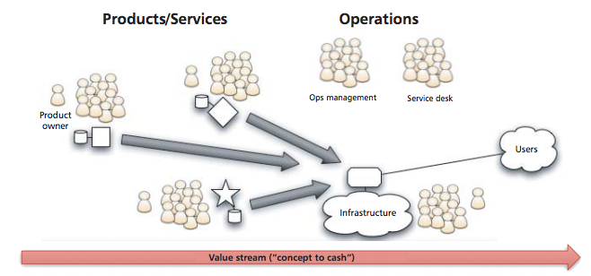
Industry View
DevOps is the practice of operations and development engineers participating together in the entire service lifecycle, from design through the development process to production support. DevOps is also characterized by operations staff making use many of the same techniques as developers for their systems work.
- the agile admin

Slide 18
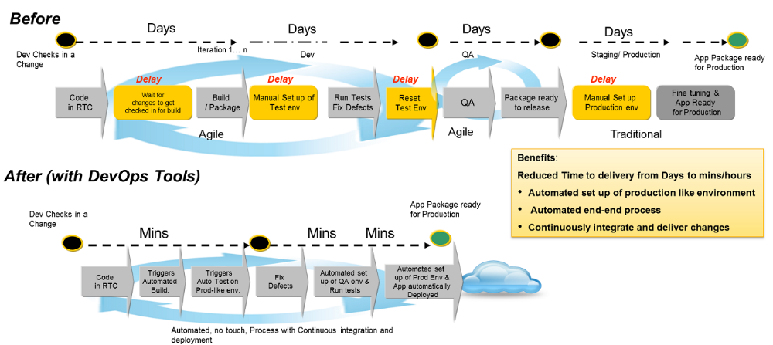
DevOps accelerates time to Delivery as promised

Slide 19
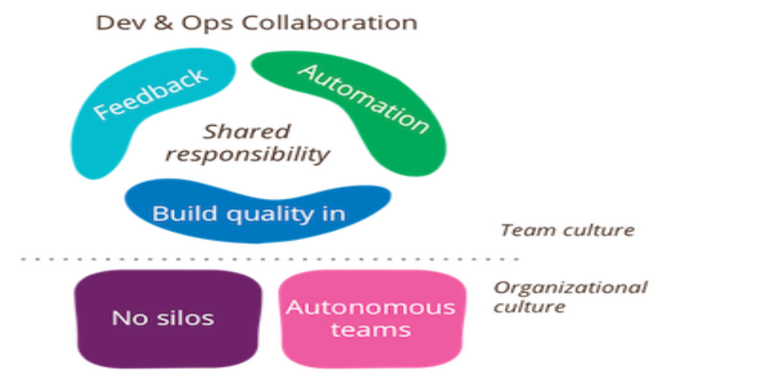
Is it yet another Buzzword?
Can be even with the best tools if we don't have the right culture*
*https://www.martinfowler.com/bliki/DevOpsCulture.html
Notes:
test

Slide 20
Success Criteria
Culture | People and process first; Efficiency is not a project manager task, it is everyone’s task.
Automation | Fabric of DevOps tools to create integrated and automated end-to-end software delivery
Measurement | Measure everything, as often as you can. Performance, process and people metrics
Sharing | Development and Operations sharing common processes, tools and culture

